Slide 1
Neural Networks
Dr.Srinivas Battula
VIT-AP University
Win 2020-21

Slide 2
Neural Networks
Why neural networks?
Model representation
Examples and intuitions
Multi-class classification

Slide 3
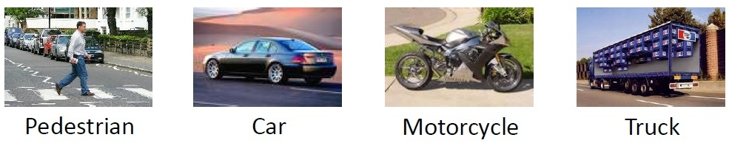







Multiple output units: One-vs-all
$${ x}_{1}$$
$${ a}_{1}^{(2)}$$
$${ a}_{1}^{(3)}$$
Pedestrian?
$${ x}_{2}$$
$${ a}_{2}^{(2)}$$
$${ a}_{2}^{(3)}$$
Car?
$${ a}_{3}^{(2)}$$
Motocycle?
Truck?

Slide 4






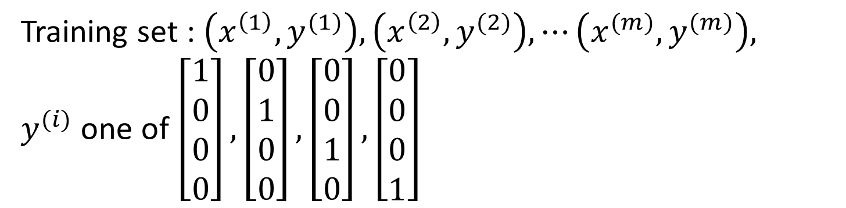


Multiple output units: One-vs-all
$${ x}_{1}$$
$${ a}_{1}^{(2)}$$
$${ a}_{1}^{(3)}$$
$${ x}_{2}$$
$${ a}_{2}^{(2)}$$
$${ a}_{2}^{(3)}$$
$$h_{Θ}\left(x\right)∈R^{4}$$
$${ a}_{3}^{(2)}$$
Training set : $\left(x^{\left(1\right)},y^{(1)}\right),\left(x^{\left(2\right)},y^{(2)}\right), ⋯\left(x^{(m)},y^{(m)}\right),$
$y^{(i)}$ one of $\left[\begin{aligned}1 \\ 0 \\ 0 \\ 0\end{aligned}\right], \left[\begin{aligned}0 \\ 1 \\ 0 \\ 0\end{aligned}\right],\left[\begin{aligned}0 \\ 0 \\ 1 \\ 0\end{aligned}\right],\left[\begin{aligned}0 \\ 0 \\ 0 \\ 1\end{aligned}\right]$

Slide 5
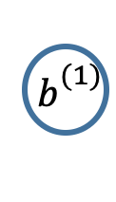

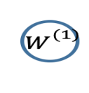
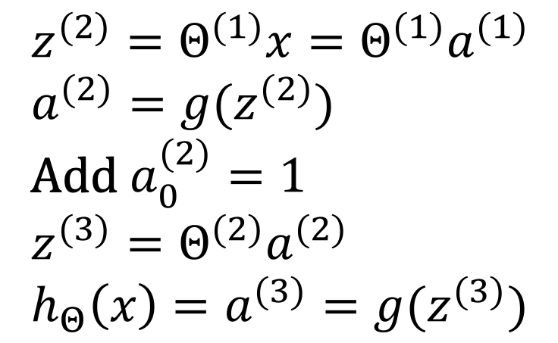


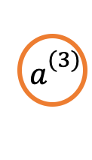
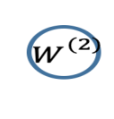
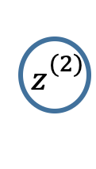
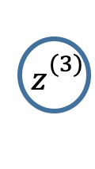
Flow graph - Forward propagation
X
$${ z}_{}^{(2)}$$
$${ a}_{}^{(2)}$$
$${ z}_{}^{(3)}$$
$${ a}_{}^{(3)}$$
$$h_{Θ}\left(x\right)$$
How do we evaluate our prediction?
$${ W}_{}^{(1)}$$
$${ b}_{}^{(1)}$$
$${ W}_{}^{(2)}$$
$${ b}_{}^{(2)}$$
$$z^{(2)}=Θ^{(1)}x=Θ^{(1)}a^{(1)}$$
$$a^{(2)}=g(z^{(2)})$$
Add $a_{0}^{(2)}=1$
$$z^{(3)}=Θ^{(2)}a^{(2)}$$
$$h_{Θ}\left(x\right)=a^{(3)}=g(z^{(3)})$$

Slide 6
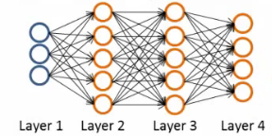
Neural Network cost function

Slide 7
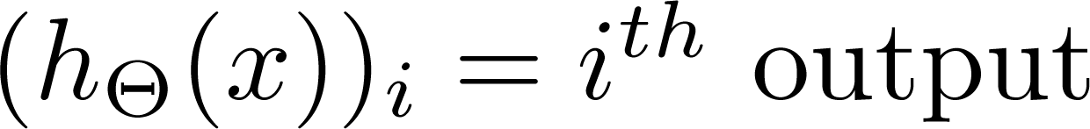

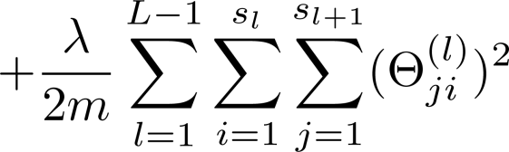
Cost function
Logistic regression:
Neural network:

Slide 8
Cost function
Our cost function now outputs a k dimensional vector
h_{Ɵ}(x) is a k dimensional vector, so h_{Ɵ}(x)_{i} refers to the ith value in that vector
Cost function J(Ɵ) is
[-1/m] times a sum of a similar term to which we had for logic regression
But now this is also a sum from k = 1 through to K (K is number of output nodes)
Summation is a sum over the k output units - i.e. for each of the possible classes
So if we had 4 output units then the sum is k = 1 to 4 of the logistic regression over each of the four output units in turn

Slide 9

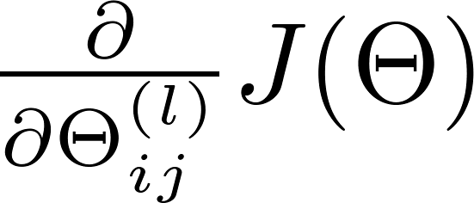
Gradient computation
This is a massive regularization summation term, it's a fairly straightforward triple nested summation.
This is also called a weight decay term ,as before, the lambda value determines the important of the two halves
The regularization term is similar to that in logistic regression. So, we have a cost function, but how do we minimize this
Need to compute:

Slide 10
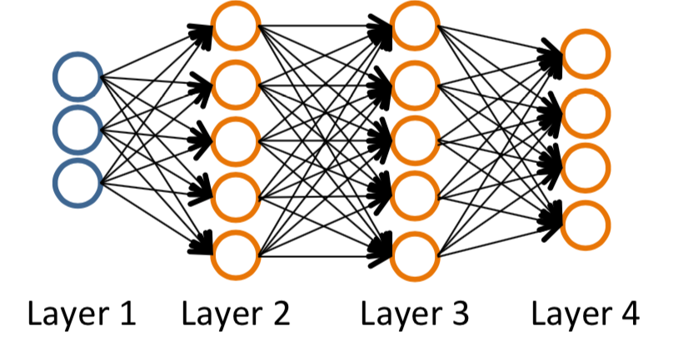

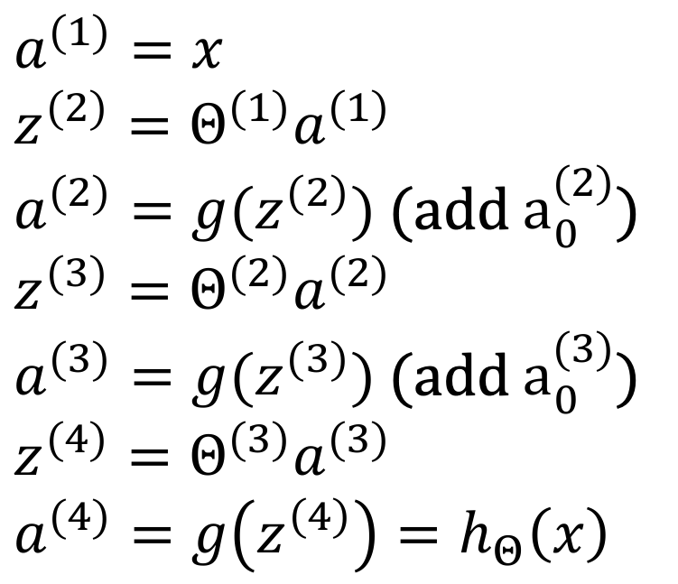
Gradient computation
Given one training example $\left(x, y\right)$
$$a^{(1)}=x$$
$$z^{(2)}=Θ^{(1)}a^{(1)}$$
$a^{(2)}=g(z^{(2)})$(add $a_{0}^{(2)}$)
$$z^{(3)}=Θ^{(2)}a^{(2)}$$
$a^{(3)}=g(z^{(3)})$(add $a_{0}^{(3)}$)
$$z^{(4)}=Θ^{(3)}a^{(3)}$$
$$a^{(4)}=g\left(z^{\left(4\right)}\right)=h_{Θ}\left(x\right)$$

Slide 11
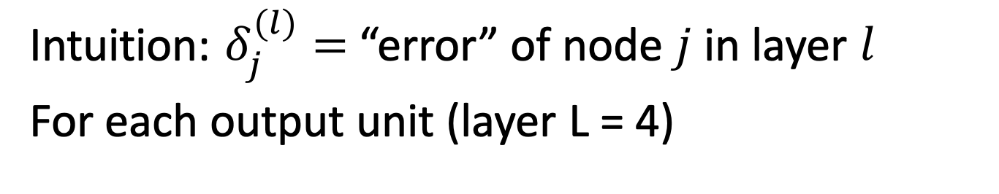
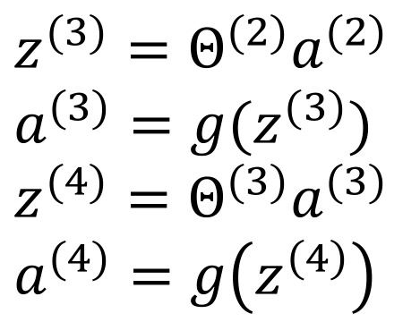
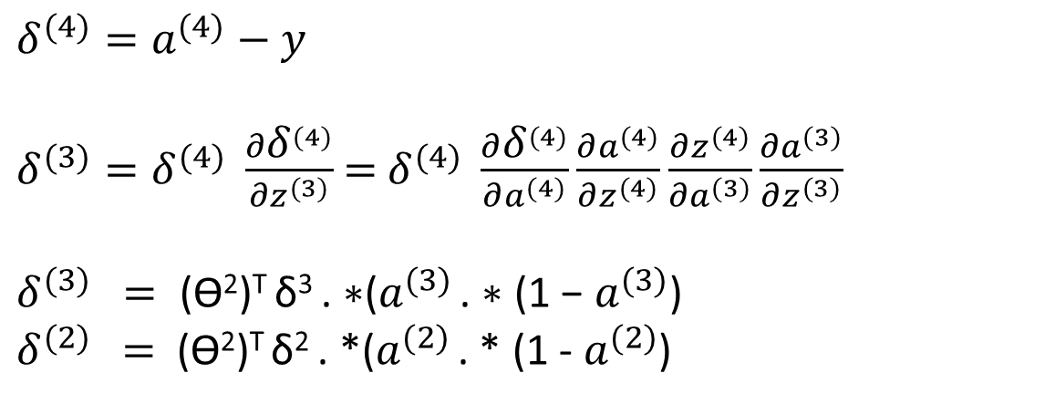
Gradient computation: Backpropagation
Intuition: ${\text{δ}}_{j}^{(l)}=$“error” of node $j$ in layer $l$
For each output unit (layer L = 4)
${\text{δ}}^{(4)}=a^{(4)}−y$
${\text{δ}}^{(3)}={\text{δ}}^{(4)} \frac{∂{\text{δ}}^{(4)}}{∂z^{(3)}}$= ${\text{δ}}^{(4)} \frac{∂{\text{δ}}^{(4)}}{∂a^{(4)}}\frac{∂a^{(4)}}{∂z^{(4)}}\frac{∂z^{(4)}}{∂a^{(3)}}\frac{∂a^{(3)}}{∂z^{(3)}}$
${\text{δ}}^{(3)}$$=\text{ (}\text{Ɵ}\text{2}\text{)}\text{T} \text{δ}\text{3 }\text{. ∗(}a^{(3)} \text{. ∗ (1 − }a^{(3)}\text{)}$
${\text{δ}}^{(2)}$$=$(Ɵ²)^{T} δ² . *($a^{(2)}$ . * (1 - $a^{(2)}$)
$$z^{(3)}=Θ^{(2)}a^{(2)}$$
$$a^{(3)}=g(z^{(3)})$$
$$z^{(4)}=Θ^{(3)}a^{(3)}$$
$$a^{(4)}=g\left(z^{\left(4\right)}\right)$$

Slide 12

Why do we do this?
We do all this to get all the δ terms, and we want the δ terms because through a very complicated derivation you can use δ to get the partial derivative of Ɵ with respect to individual parameters (if you ignore regularization, or regularization is 0)
= = a_{j}^{l} δ_{i}^{(l+1)}
By doing back propagation and computing the delta terms you can then compute the partial derivative terms
We need the partial derivatives to minimize the cost function!

Slide 13
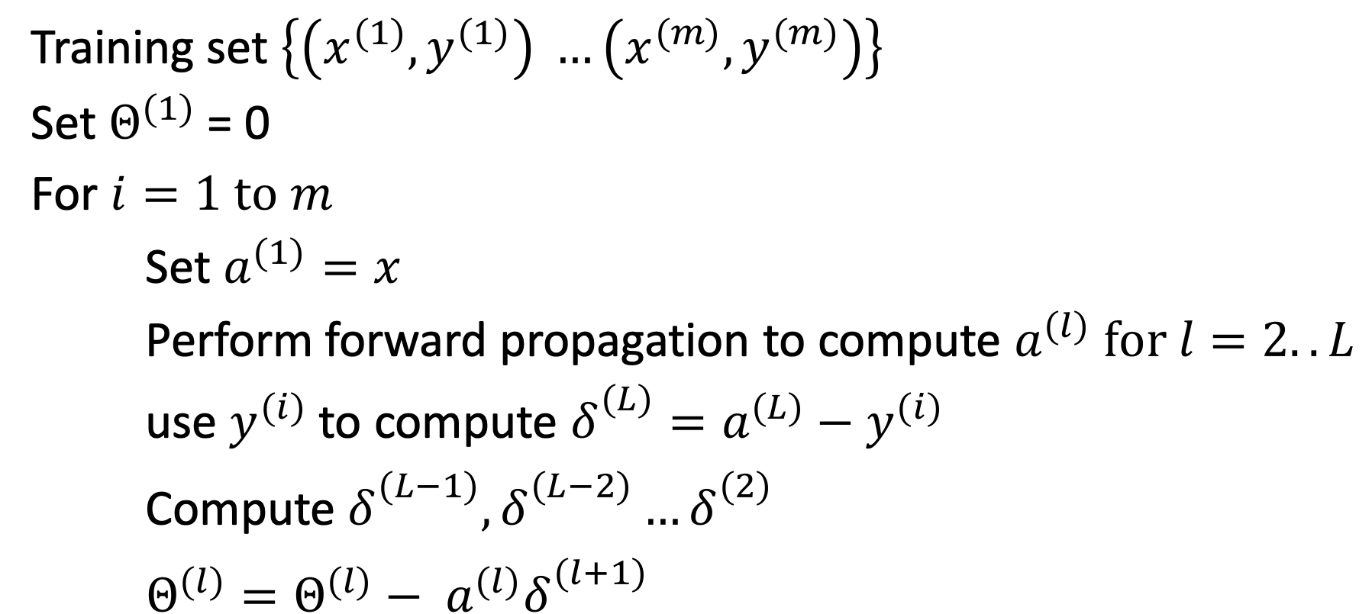
Backpropagation algorithm
Training set $\left\{\left(x^{(1)},y^{(1)}\right) …\left(x^{(m)},y^{(m)}\right)\right\}$
Set $Θ^{(1)}$ = 0
For $i=1 to m$
Set $a^{(1)}=x$
Perform forward propagation to compute $a^{(l)} for l=2..L$
use $y^{(i)}$ to compute ${\text{δ}}_{}^{(L)}=a^{(L)}−y^{(i)}$
Compute ${\text{δ}}_{}^{(L−1)},{\text{δ}}_{}^{(L−2)}…{\text{δ}}_{}^{(2)}$
$Θ^{(l)}=Θ^{(l)}− a^{(l)}{\text{δ}}_{}^{(l+1)}$

Slide 14
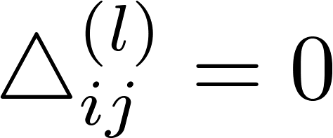


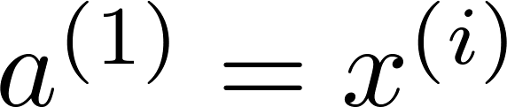

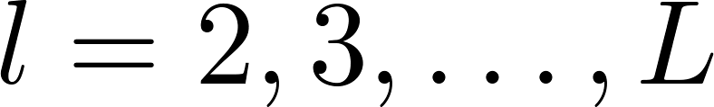

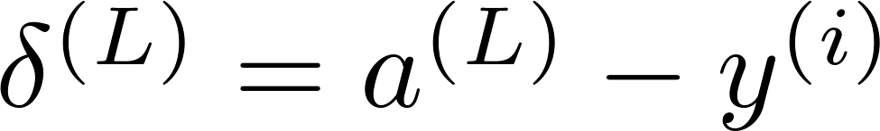
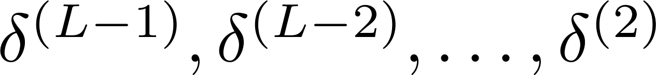
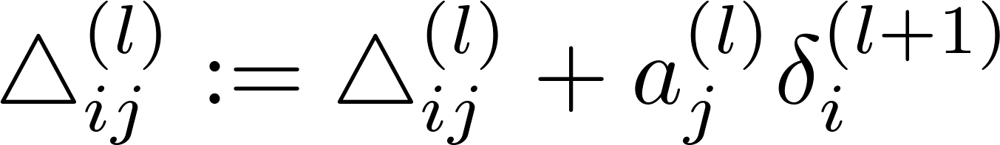
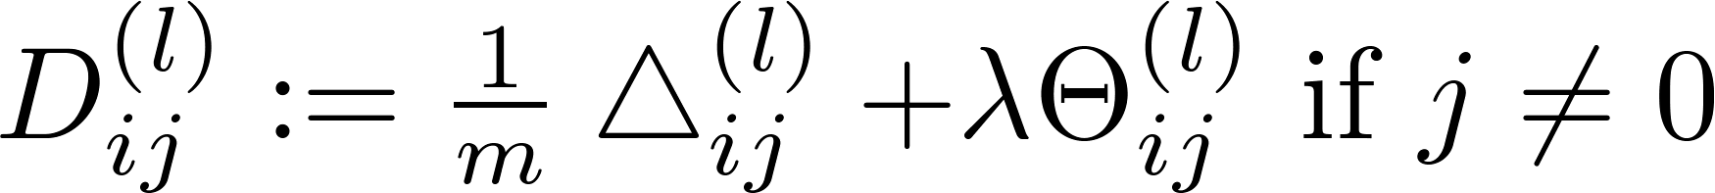
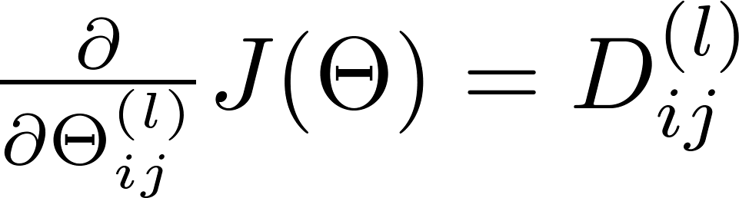
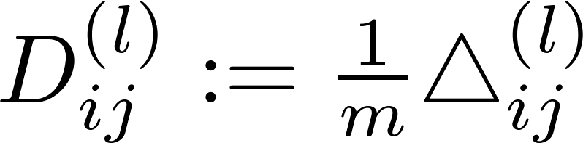

Backpropagation algorithm
Training set
Set (for all ).
For
Set
Perform forward propagation to compute for
Using , compute
Compute
Derivative

Slide 15
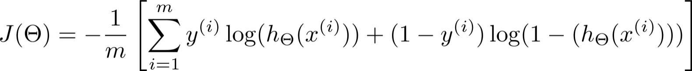
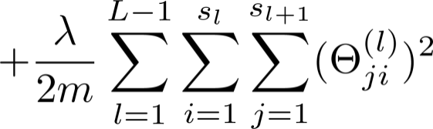


What is backpropagation doing?
Focusing on a single example , , the case of 1 output unit, and ignoring regularization ( ),
You can think of cost function as a mean square error function to get a better intuition of back propogation algorithm
(Think of )
I.e. how well is the network doing on example i?

Slide 16
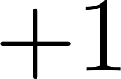


Forward Propagation

Slide 17








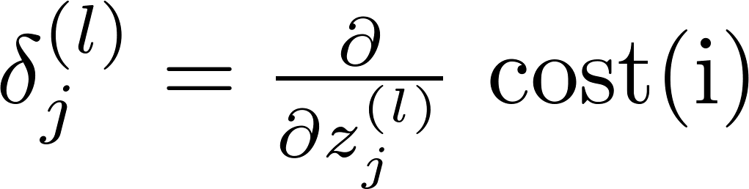

Forward Propagation
Propagating delta back and computing new delta at layer L-1
“error” of cost for (unit in layer ).
Formally, (for ), where

Slide 18
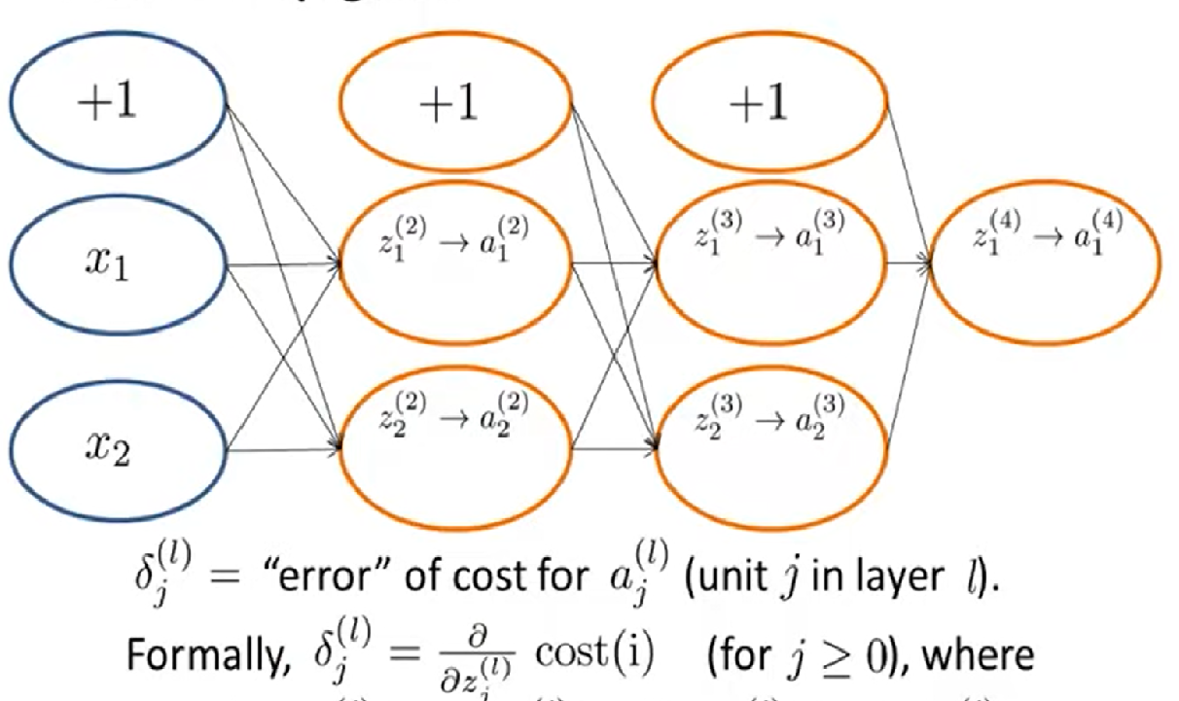
Back Propagation

